Slide 1

BIC Bank Audit Process Automation
Pratham
Pavan Adari
We present an innovative solution for automating audit processes at Best-in-Class (BIC) Bank, a global investment bank offering wealth management and custodian services.

Slide 2


Company Background
1
Global Investment Bank
BIC Bank offers comprehensive financial services worldwide.
2
Wealth Management
Provides expert advisory services for high-net-worth clients.
3
Custodian Services
Safeguards and manages clients' financial assets securely.

Slide 3




Our Solution
Automated Extraction
AI-powered system extracts data from bank statements efficiently.
ML Processing
Advanced algorithms process and analyze extracted financial data.
Streamlined Reporting
Generates comprehensive audit reports with minimal manual intervention.

Slide 4
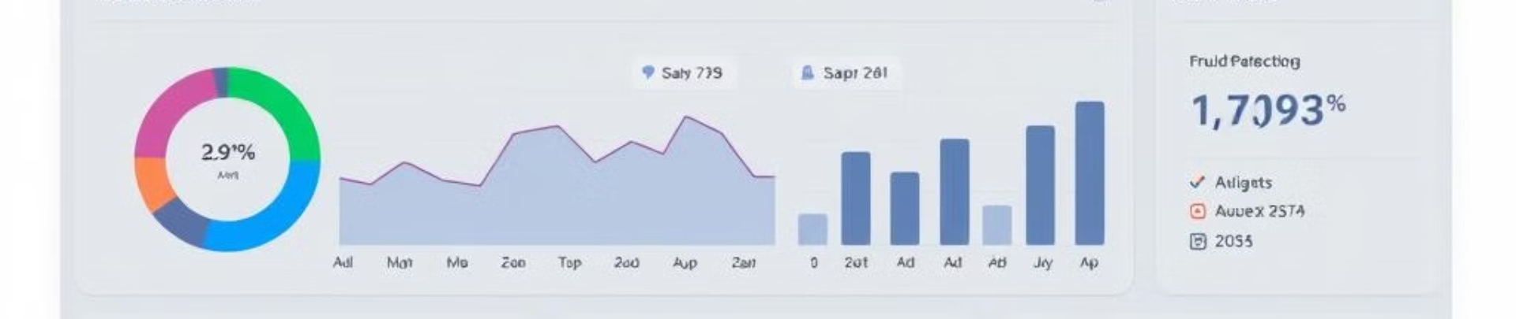




Key Features
Data Extraction
User Interface
Fraud Detection
Data Export
Automated extraction from bank statements with high accuracy.
Intuitive UI for easy data interaction and visualization.
Advanced algorithms identify potentially fraudulent transactions.
Flexible options for saving and exporting processed data.

Slide 5
Technology Stack
Gen AI
Front-end
Back-end
Advanced algorithms for accurate data extraction and processing.
User-friendly interface built with modern web technologies.
Robust server-side processing for data management and analysis.

Slide 6

Benefits
Efficiency
Accuracy
Streamlined audit reporting process saves time and resources.
Reduced manual errors lead to more reliable audit results.
Cost Savings
Compliance
Automated processes significantly cut operational expenses.
Enhanced adherence to regulatory requirements in financial auditing.

Slide 7

Future Enhancements
1
Document Integration
Expand capabilities to process various financial document types.
2
Advanced Analytics
Implement sophisticated reporting and predictive analysis features.
3
Mobile Application
Develop a mobile app for convenient on-the-go auditing.

